Slide 1

EQUALLY WELL: A NATIONAL PERSPECTIVE
Dr Murray Wright
Chair, Safety and Quality Partnership Standing Committee
(A Standing Committee of the Mental Health Principal Committee)
29 March 2019
Notes:
Talk about the governance/ reporting processes and changes to patient safety in mental health, and their relevance

Slide 2
SAFETY & QUALITY PARTNERSHIP
STANDING COMMITTEE (SQPSC)
Notes:
To provide technical advice and recommendations to MHPC on development of national policy and strategic direction for patient safety and quality in mental health services
Support and implementation role with actions of the 5th National Mental Health and Suicide Prevention Plan
Chief Psychiatrists, ACSQHC, MHA, Private Hospitals, Commonwealth, Consumer, Carer, MHISSC, Community Mental Health Australia, NMHC, NZ Ministry of Health
Reporting lines

Slide 3
FIFTH NATIONAL MENTAL HEALTH & SUICIDE PREVENTION PLAN

Slide 4
“Governments will develop a National Mental Health Safety and Quality Framework …
The Framework will describe the national agenda and work program for safety and quality over the next five years …”
The Fifth National Mental Health and Suicide Prevention Plan – Implementation Plan - October 2017 - Action 21 - Page 27
Notes:
21.1 SQPSC will work with ACSQHC to update the National Safety Priorities in Mental Health
21.4 SQPSC will work with ACSQHC to develop a suitable process for revising the National Standards for Mental Health Services
21.5 SQPSC will develop an approach to ensure all relevant service delivery sectors are covered by the framework

Slide 5
‘All Governments and mental health commissions will embed the elements of Equally Well and take action in their areas of influence to make changes towards improving the physical health of people with mental illness.’
Notes:
Action 14This is our goal/target, and the role of national groups like the SQPSC and NMHC is to keep track of this goal, monitor progress, and find ways to facilitate change and improvement

Slide 6
SQPSC & Restrictive Practice
Notes:
As an example of a National effort to implement change.
Key issues- duration of effort, goal setting (KPIs), data collection (monitoring), sharing success and workshopping challenges, advocating for resource

Slide 7
Staying true to a consumer focus, and closely monitoring & sharing outcomes/success/challenges at every level of the health system
Notes:
Still with restrictive practice as an example—Beacon sites, TERP Forum
And it has taken many years to build improvement into the system (still going)

Slide 8
Clinical Governance & Improvement Science
Notes:
Measuring without methodology and an improvement framework leads nowhere

Slide 9
“A framework through which health organisations are accountable for continuously improving the quality of their services & maintaining high standards of care by creating an environment in which excellence in clinical care will flourish”
Clinical Governance
Notes:
Continuous, multilevel, all the way to National (and international)
Meaningful engagement with the data and the issues from the team level through to the national level

Slide 10
Patient Safety Framework &
Improvement Science
Historical over-reliance on top down improvements – Policy, Standards, ‘Programs’
Changing paradigm –bottom up, co-design, data driven, change methodology

Slide 11
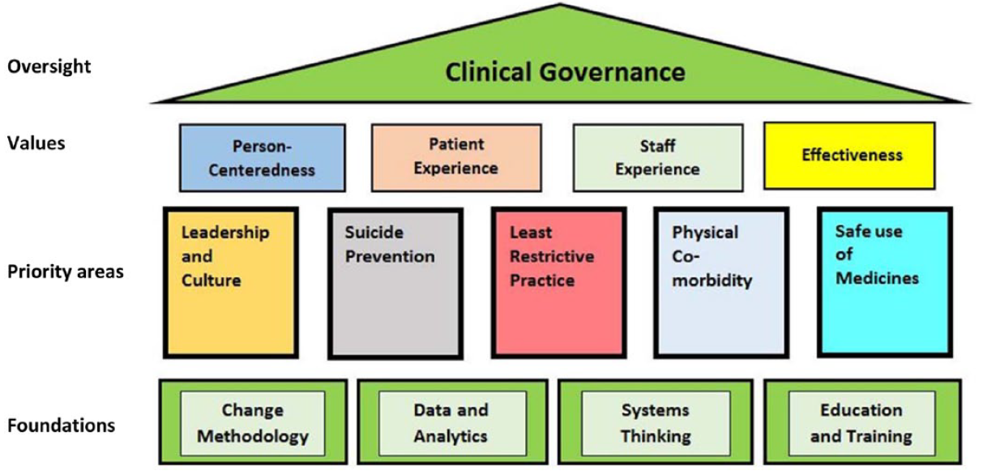
A new paradigm for mental-health quality and safety: are we ready? B Short et al; 24 September 2018, https://doi.org/10.1177/1039856218797423

Slide 12
Supporting teams to find solutions to meet goals. (PDSA)
Notes:
This is the outcome of implementing a ‘re balanced ‘ framework.
This is what we are interested in at the National level.

Slide 13
Reporting success (or challenges) at all
levels State National
  Benchmarking/sharing
  Identifying & sharing innovations
  Shaping future strategies
  Making the case for resources
Notes:
It is continuous, and in addressing the elements of EW, we will no doubt bring into focus new areas of focus for improvement
TERP is to become a mental health patient safety forum, will include physical health issues

