Slide 1
Where best to invest to enable meaningful reform
by John Allan
Executive Director MHAODB Queensland
President Elect RANZCP
www.equallywell.org.au

Slide 2
“best return on investment”
This is a call to arms
develop focus areas for reform such as
education
consumer empowerment
health service standards
service development
applied to your current role and context
three examples of different types and tips
www.equallywell.org.au

Slide 3
What drives change?
Leadership
Change in human behaviour
Incentive
Money
A good idea
Policy and evidence are necessary but not always the drivers
The “burning platform” may be more about establishing a compelling story than crisis and seeking to sustain not just initiate
www.equallywell.org.au

Slide 4
Top-Down to lead Bottom-Up
National project on Reduction and where possible elimination of seclusion and restraint to The Elimination of Restrictive Practices
Show graph
Success – necessary, combined leadership, common goal, publication of data common definitions , stated strategy 10 year process of attitude and behaviour change tangible feedback mechanism, overcame fear and stigma to shine a light on something, the target behaviour was not the stated goal (reduction in seclusion) but processes much further up the line (welcoming and recovery)
Problems – variation in response and uptake, arguments why we can’t change
www.equallywell.org.au

Slide 5
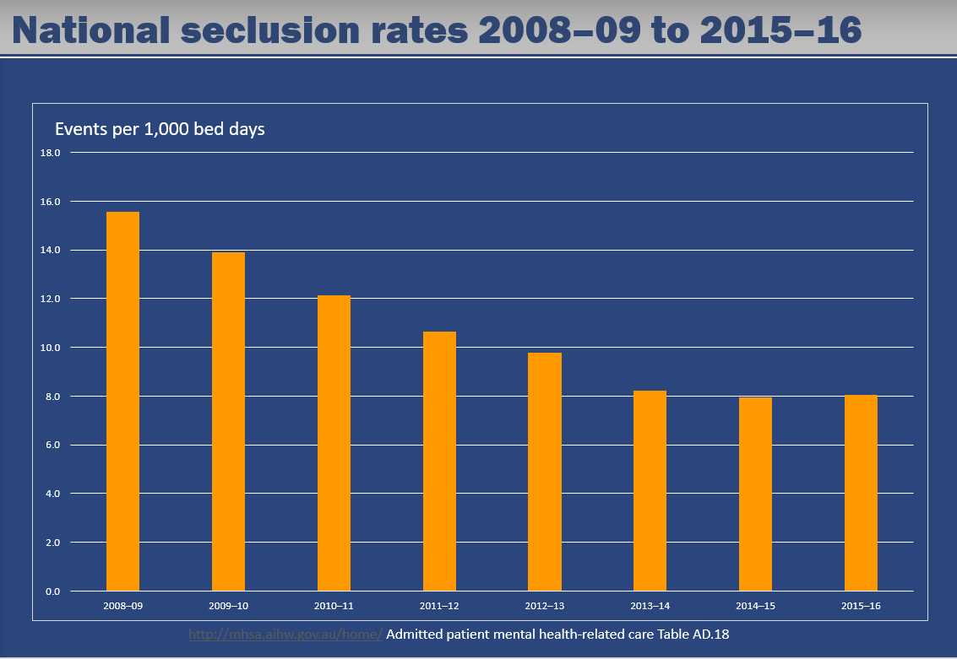
www.equallywell.org.au

Slide 6
Bottom-Up to show Top-Down something new
Indigenous smoking
Indigenous Queenslander adults were 2.5 times more likely to smoke daily than non-Indigenous adults.
75% of indigenous consumers smoke
www.equallywell.org.au

Slide 7
Bottom-Up recognised by Top-Down as mutual benefit
Queensland Clinical Collaborative and QUIP payments to increase awareness of smoking and place people on pathways to quitting in a clinical setting
Success: came from problem identified by people on the floor, offered a tangible incentive to overcome ambivalence and allowed pride in changing behaviour while tackling the fear (what if he gets violent), makes both people effective, fit with a policy opportunity
Problems when leadership is lacking, continuation of effort, cost afterwards not always covered, what about everything else?
www.equallywell.org.au

Slide 8
The role of Public Policy
Public policy refers to the principles that underpin courses of action, regulatory measures, laws, and funding priorities promulgated by a governmental entity i.e. administrative and executive branches
The main aim of health public policy is to create a supportive environment to enable people to lead healthy lives and is characterized by an explicit concern for health and equity
www.equallywell.org.au

Slide 9
Who actually drives the reform agenda?
You do more than you think
Some common beliefs
Clinicians have little say
Non clinicians aren’t genuine
Letters to the minister have weight
Every decision is logical
Unsolicited proposals fail, personal representation is impossible
Most decisions are made in a logical policy flow usually in response to evidence or pressure (scandal, media, political pressure e.g. elections)
www.equallywell.org.au

Slide 10
Policy tips for the Smoking in mental health initiative
Work out who is addicted to what
Join with an accepted program e.g. physical health care
Respect your partner’s capacity to bring a fresh set of ideas which may challenge you
Endlessly talk to your critics – they might change
Get noticed by others- they may want to give you money
Identify your leaders who may not always be obvious
Introduce evidence but be patient
www.equallywell.org.au

Slide 11
Advocacy isn’t just a matter of presenting the overwhelming facts – other barriers
Culture
Ambivalence
Isolation
Confirmation biases
Self serving biases
Conflation of argument
Myths
Implementation fatigue
Resource priorities
www.equallywell.org.au

Slide 12
Critical factors for success
More than one strategy
Do not over rely on one person or pathway
Consumers are more valuable to influence opinion than professionals in certain instances only
Good for awareness
Less so for action
www.equallywell.org.au

